Slide 1

Predicting FIFA transfer value from in-game player statistics
By Sophie, Sarah and James

Slide 2
What were our aims and data source?
What were our initial models?
How did we refine our process?
Final model and implications.
Notes:
Sophie

Slide 3
Motivations
•Original Aim : Can we predict real life transfer value from in-game FIFA stats
•Illogical, too many unquantifiable factors (market dynamics, cyclical economics, financial fair play, regulations etc…)
•Revised aim : Predict in-game transfer value from in-game fifa stats.
•Players of FIFA can accurately value their players, as well as accurately value transfer targets.
Notes:
James
Original Aim : Can we predict real life transfer value from in-game FIFA stats
•Found this to be illogical, too many factors exist separate from the players qualities (market dynamics, cyclical economics, financial fair play, regulations etc…)
•Revised aim : Predict in-game transfer value from in-game fifa stats
•This will serve to allow players of FIFA to more accurately value their players, as well as accurately value transfer targets

Slide 4


Background
• FIFA or EAFC has 10 million players worldwide.
• Its player database includes 17,000 players
• 40 individualised statistics regarding player quality
• Enhances realism
• Statistics are reflective of real life performance.
• Depth of stats allows for strategic gameplay.
Notes:
James
FIFA is a massively popular video game, enjoyed by over 10 million players worldwide.
•Its extensive player database includes 17,000 players, each meticulously crafted with over 40 individualized statistics.
•The game's realism is enhanced by this detailed data, providing an immersive experience for gamers.
•With regular updates and additions to the database, FIFA remains dynamic and reflective of real-world player performances.
•The depth of player stats allows for strategic gameplay, catering to both casual and competitive gamers alike.

Slide 5

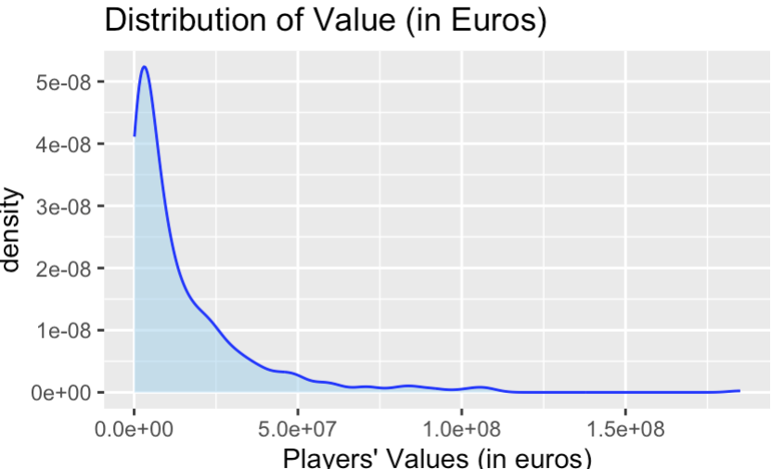
Initial dataset
Data was taken from kaggle
180,000 entries
Over 40 variables for each player entry
After Wrangling
Premier League outfield players (2024)
Pace, Shooting, Passing, Dribbling, Defending, Physicality
Response variable is in-game Transfer value (euros)
Notes:
Sarah

Slide 6

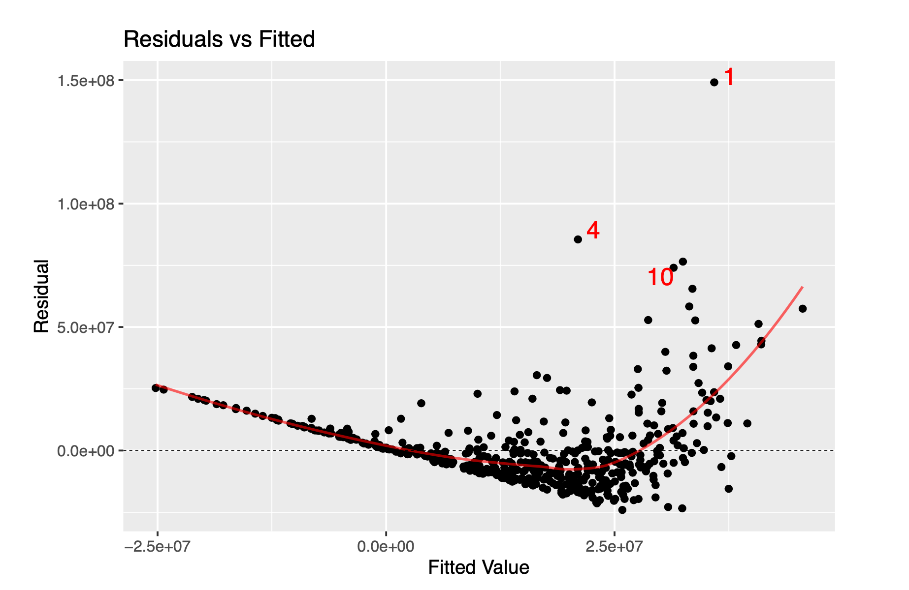
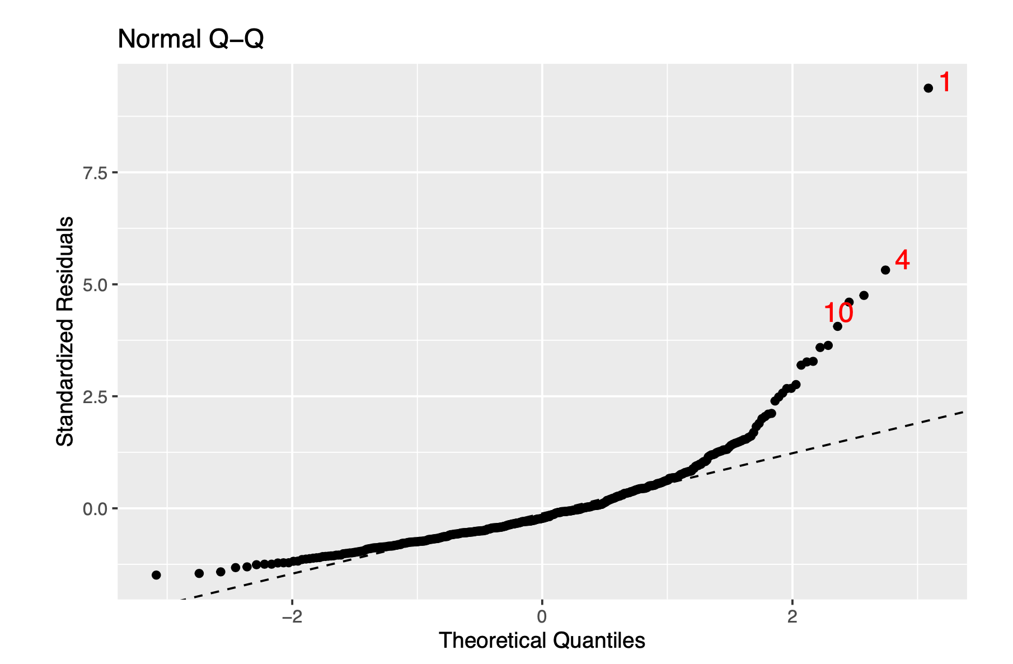
Initial Model
Kitchen-sink model → Pace, Passing, Physicality, Shooting, Dribbling, Defending
Issues with our conditions
Transformation of our response variable → Log
Notes:
Sarah
Ran a kitchen-sink multiple linear regression model and found significance in pace, passing, and physic
Noticed a curved relationship in our residuals vs fitted plot as well as a long tail in our Q-Q plot
Transformation of our response variable → Log

Slide 7
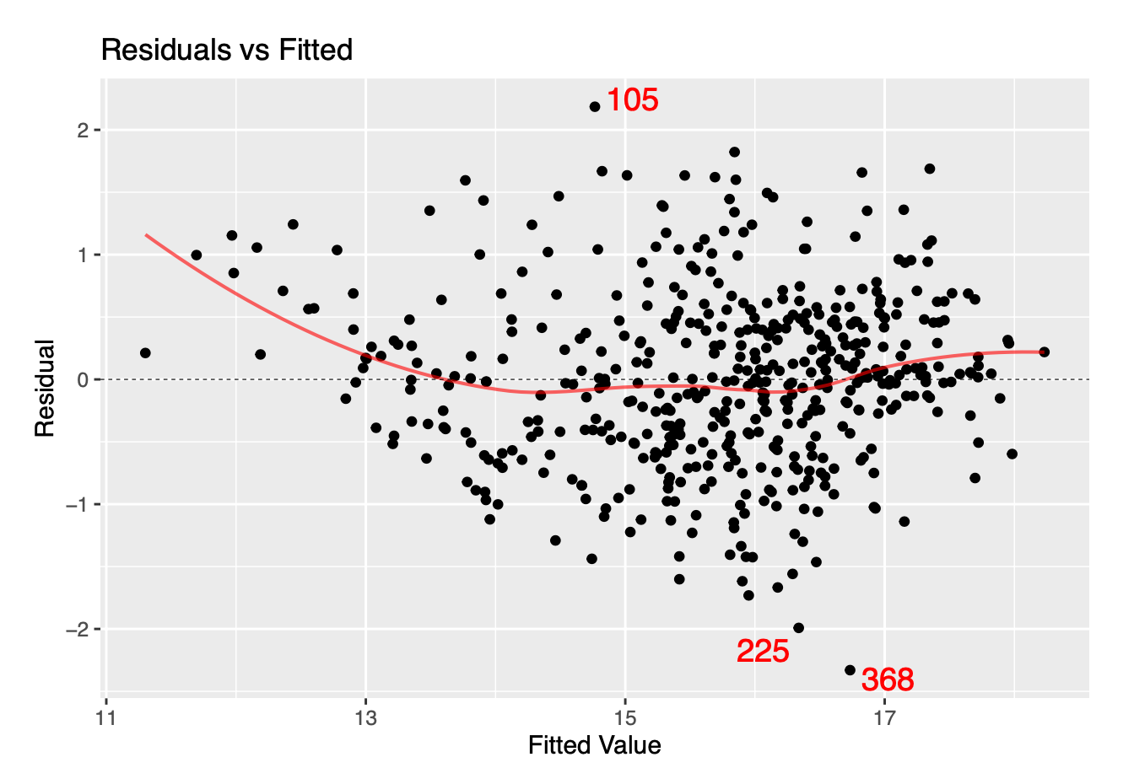
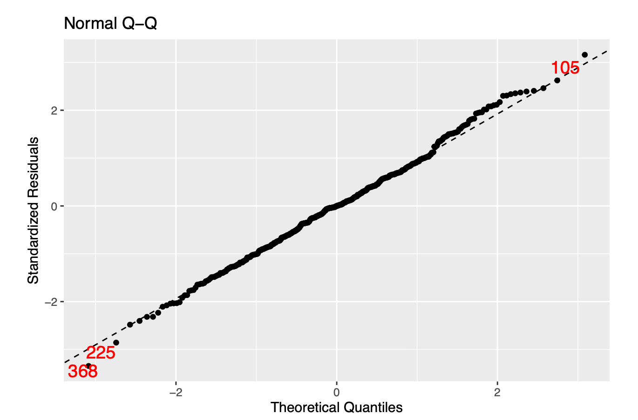
Initial results after Log
Log kitchen-sink → Pace, Passing, Physicality, Shooting, Dribbling, Defending
Notes:
Sarah
With logarithmic model pace, shooting, dribbling, passing and physic were all significant predictors
Accounting for best subsets and multicollinearity we ended up with passing, physic and dribbling

Slide 8

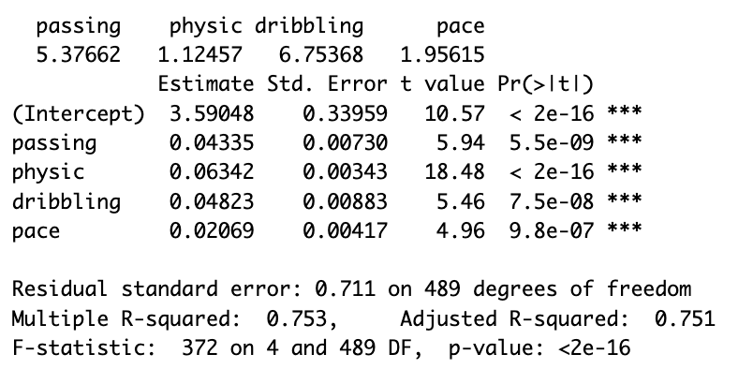
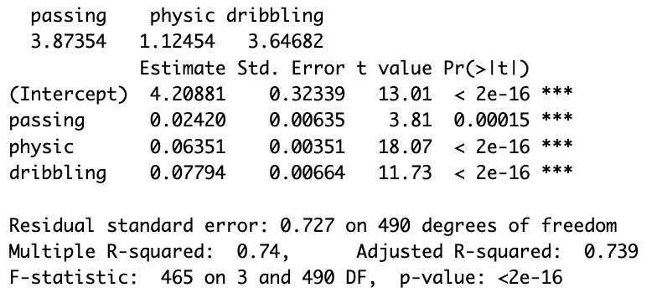
Log-based models
Best subsets + multicollinearity checks
4-variable
3-variable
Notes:
Sarah
With logarithmic model pace, shooting, dribbling, passing and physic were all significant predictors
Accounting for best subsets and multicollinearity we ended up with passing, physic and dribbling

Slide 9
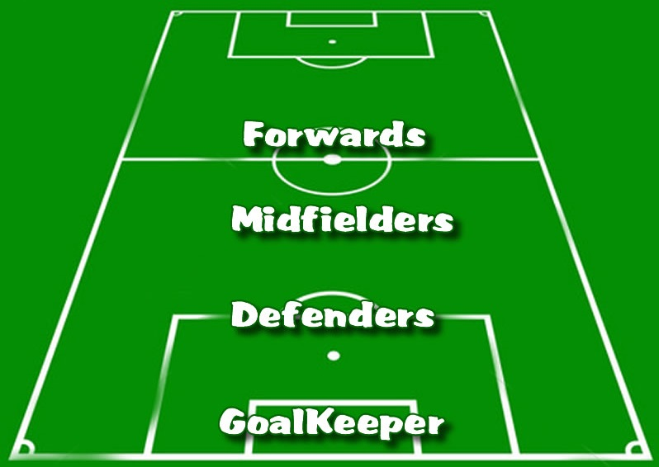
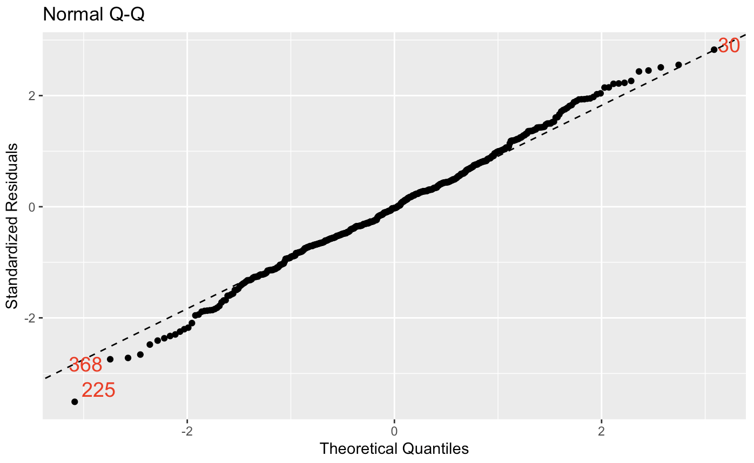
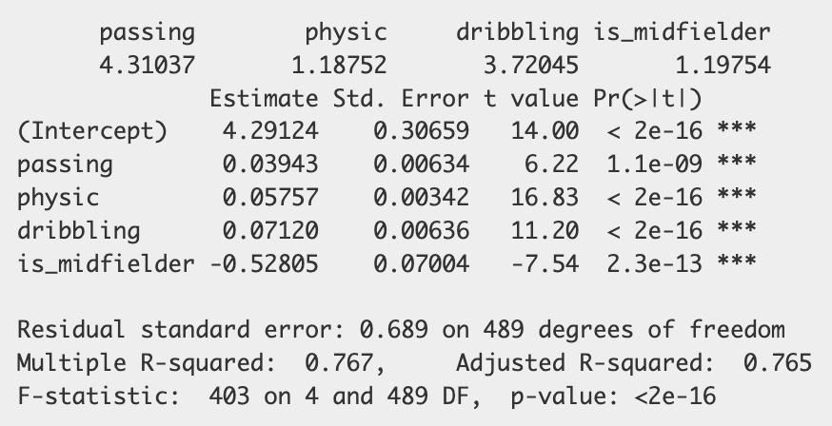
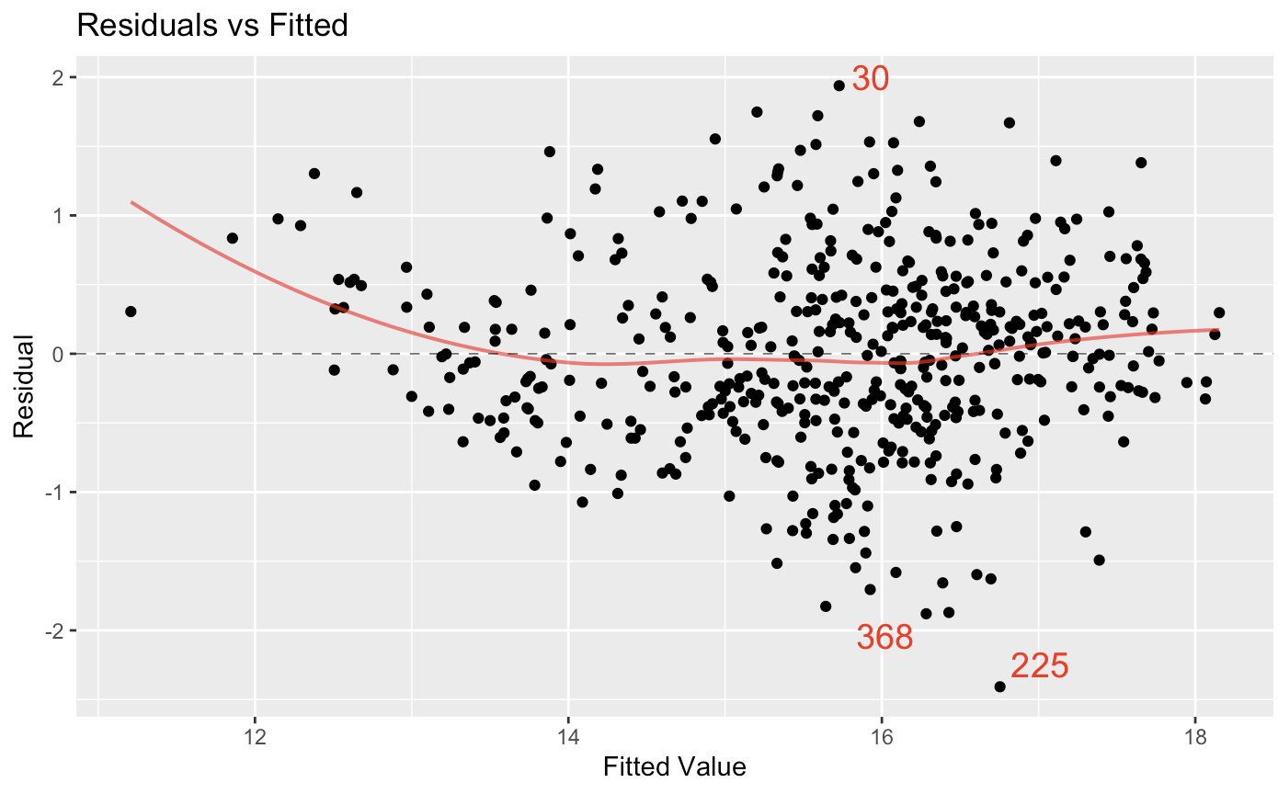
Refining Our Processes
Would including position yield interesting results and improve our model?
Being a midfielder is significant in predicting in-game transfer value and being a defender or an attacker/forward is not
Notes:
Sophie

Slide 10

Limitations
This does not predict real life transfer value
This only predicts Premier League in-game transfer value
This model only applies to the 2024 version of the game, and results cannot be extended to other versions of the franchise (FIFA or EAFC)
Notes:
Sophie

Slide 11
Conclusions
Our significant predictors were passing, physical, dribbling and is_midfielder
We have proved that a large portion of a players in-game value can be derived from their in-game stats.
76.5% of variance
Players can use our model to value their players more accurately
This makes their transfer dealings more efficient
Possible template for determining real life transfer value
Notes:
James

Slide 12
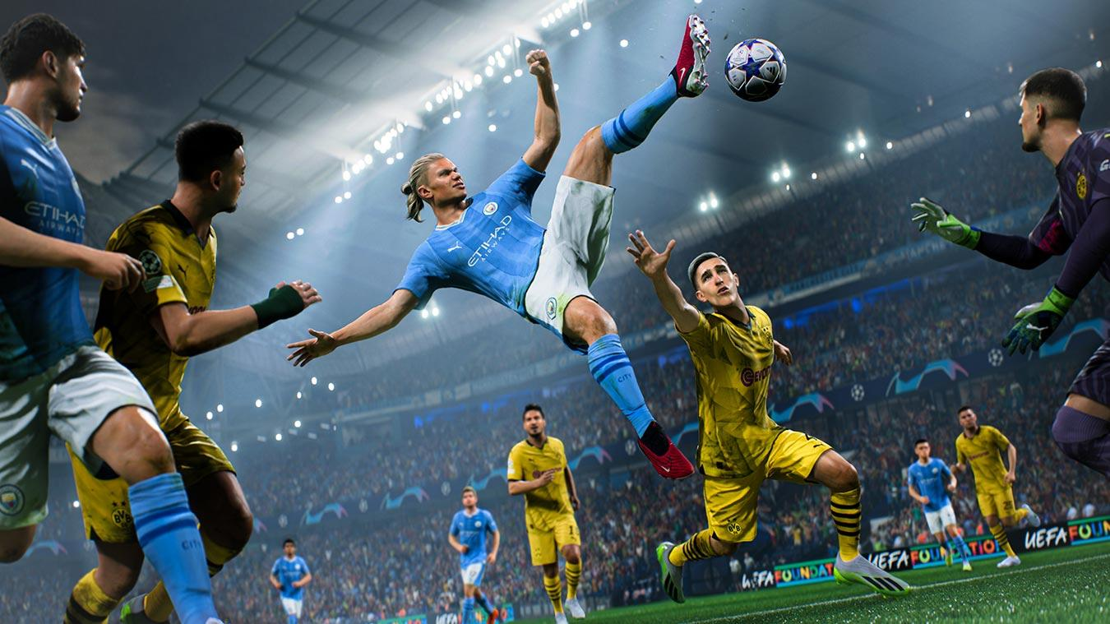
Thank You! .

